Slide 1
Growing Wisconsin’s Food and Agricultural Exports
Wisconsin Agricultural Export Webinar – February 2023
Lisa Stout International Consultant, DATCP International Agribusiness Center
Wisconsin Department of agriculture, trade and Consumer protection
February 15, 2023

Slide 2
Wisconsin Agricultural export webinar – February 2023
AGENDA
Welcome and Opening Remarks
Secretary Randy Romanski
Export Expansion Grant FY22 Project Updates
Wisconsin Holstein Association – Ron Sersland President of Our Help Inc. (International Protein Sires)
Wisconsin Potato and Vegetable Growers Association (WPVGA), Dana Rady – Executive Director WPVGA, David Wickline - Sales and New Business Development Manager, Alsum Farms & Produce
Applying for the WEDC International Market Access Grant
Katie Ujdak – Global Trade and Investment Grant Specialist, Wisconsin Economic Development Corporation
Trade Promotion Activities February through June of 2023
Lisa Stout – International Development Consultant
Adjourn

Slide 3
Wisconsin Agricultural export webinar – February 2023
AGENDA
Welcome and Opening Remarks
Secretary Randy Romanski
Export Expansion Grant FY22 Project Updates
Wisconsin Holstein Association – Ron Sersland President of Our Help Inc. (International Protein Sires)
Wisconsin Potato and Vegetable Growers Association (WPVGA), Dana Rady – Executive Director WPVGA, David Wickline - Sales and New Business Development Manager, Alsum Farms & Produce
Applying for the WEDC International Market Access Grant
Katie Ujdak – Global Trade and Investment Grant Specialist, Wisconsin Economic Development Corporation
Trade Promotion Activities February through June of 2023
Lisa Stout – International Development Consultant
Adjourn

Slide 4
WI Export Expansion
Dana Rady, WPVGA
David Wickline, Alsum Farms & Produce

Slide 5
Grant #1 (May 2022 – 2024) - $45k
Identify Canadian & Mexican market opportunities
Participate in Canadian produce marketing association – April 2023
Host reverse trade mission in Wisconsin – fall 2023 / spring 2024

Slide 6
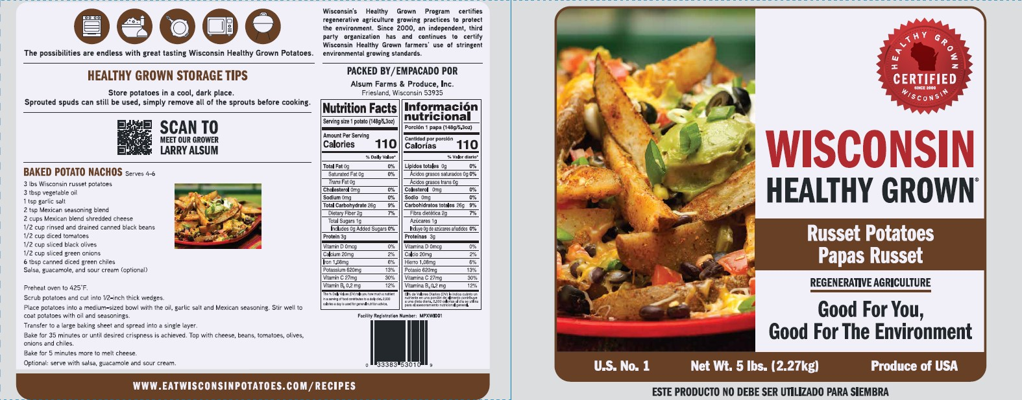
Identify Market Opportunities in Canada & Mexico
- Develop promotional materials with sustainability messaging
5 and 10# russet bags translated to Spanish
Healthy Grown messaging to promote environmentally-friendly practices

Slide 8
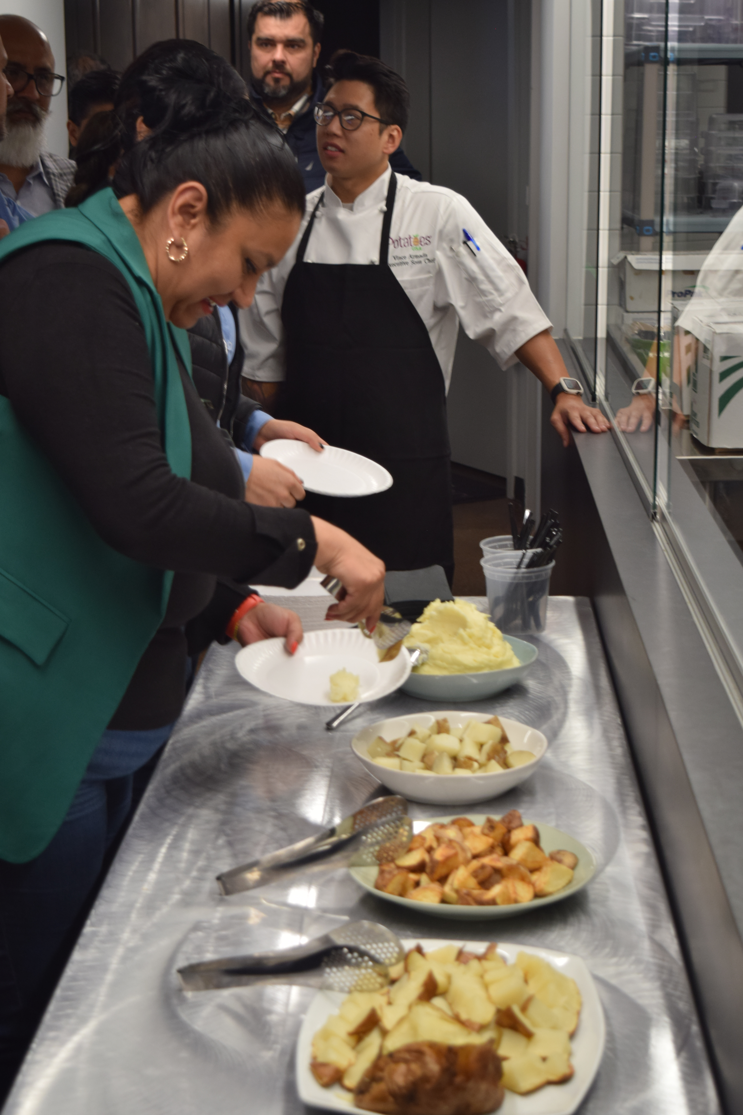
Identify Market Opportunities in Canada & Mexico
- Mexico Reverse Trade Mission (October 2022)
Participation from Alsum Farms & Produce and WPVGA

Slide 9
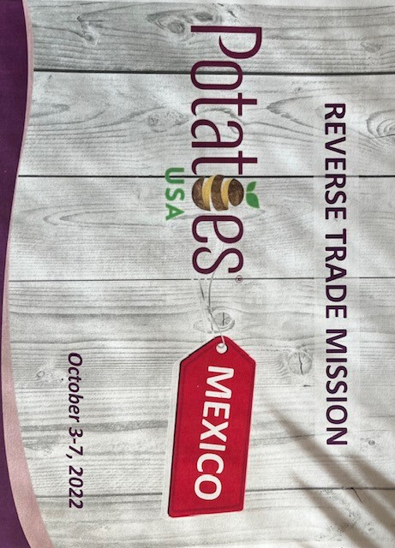

Slide 10
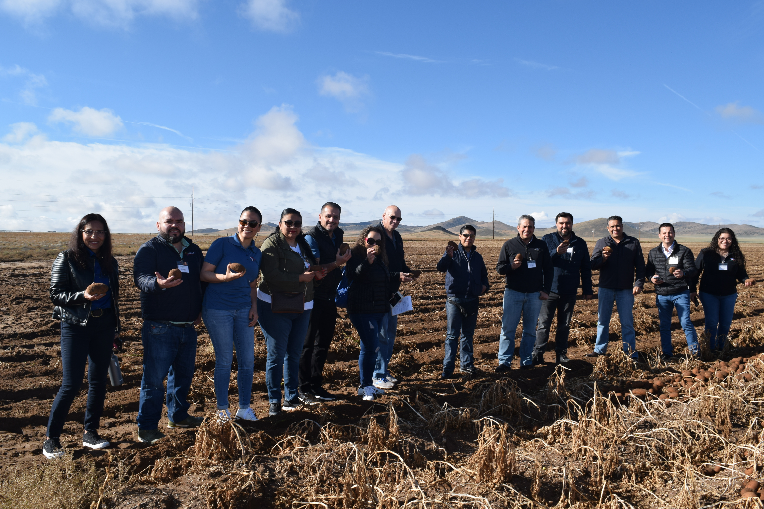
Mexico Reverse Trade Mission
Sponsored by Potatoes USA
15 Mexican Companies
Pre-qualified Buyers
Already purchasing Potatoes from USA or interested buying from a US producer
Established Credit
Face-to-face meetings
Invaluable SAVINGS of both TIME & MONEY

Slide 11
Grant #2 (January 2023 – 2025) - $50k
Create Materials for specific Mexican (fresh/chip) & Canadian (seed) markets
Participate in Mexican trade show - 2024
Host Mexico reverse trade mission in Wisconsin – 2024 / 2025

Slide 12
Thank you

Slide 13
Wisconsin Agricultural export webinar – February 2023
AGENDA
Welcome and Opening Remarks
Secretary Randy Romanski
Export Expansion Grant FY22 Project Updates
Wisconsin Holstein Association – Ron Sersland President of Our Help Inc. (International Protein Sires)
Wisconsin Potato and Vegetable Growers Association (WPVGA), Dana Rady – Executive Director WPVGA, David Wickline - Sales and New Business Development Manager, Alsum Farms & Produce
Applying for the WEDC International Market Access Grant
Katie Ujdak – Global Trade and Investment Grant Specialist, Wisconsin Economic Development Corporation
Trade Promotion Activities February through June of 2023
Lisa Stout – International Development Consultant
Adjourn

Slide 14
International Market Access Grant
2023 Grant Cycle
February 15, 2023
Notes:
Welcome to our Export Resources Webinar
First, who we are (BRIEFLY)
Second, how our grant program can help you

Slide 15
Global Trade & Investment
Notes:
WEDC is a state agency that supports the economic growth of Wisconsin businesses and communities.
One of the areas we support is export development, which falls with the Division of Global Trade and Investment. Our mission as a division is to enhance Wisconsin's global competitiveness by accelerating exports and promoting Wisconsin as a foreign direct investment destination. We offer several different technical assistance and financial assistance programs to help grow Wisconsin exports. One of those the International Market Access Grant

Slide 16
International Market Access Grant
Notes:
Through the Global Business Development Program we offer:
The INTERNATIONAL MARKET ACCESS GRANT (IMAG) - Wisconsin companies can be reimbursed for specific short-term expenses associated with a targeted export project that will help to grow their presence in their identified international market(s).

Slide 17
Allowable Expenses
Trade Shows
Marketing & Promotion
Consulting Services
Export Education
Transportation
and Lodging
registration, booth construction, one-time shipping, interpreters, non-WEDC trade missions
website development, translation of marketing materials, IP registration, product certification
WEDC trade reps, US Commercial Service, website designer, partner search or market research
cultural competency, best business practices in foreign markets, export compliance, foreign language
match only—not reimbursable
Notes:
Extremely flexible
Highlight trade reps

Slide 18
Budgeting & Reimbursement
Tiered support
Up to $10,000 for eligible applicants
Up to $25,000 for ExporTechTM Graduates
30% match required
All expenses must be invoiced and paid within project window
Retain invoices for each expense
WEDC will analyze all invoices to approve a disbursement
Notes:
The grant is a reimbursement grant, meaning you will initially pay for the projects out of your own budget. Once you’ve paid for an expense, you can submit a reimbursement request to us. We will analyze all the invoices you send and determine a reimbursement amount. Expenses incurred or paid before the application is formally accepted cannot be reimbursement. All expenses must be invoiced and fully paid off by your project end date.

Slide 19
Application Process
PORTAL
Get Network Wisconsin access from Katie Ujdak
Complete application in Network Wisconsin portal
Wait 6-8 weeks for preliminary decision
If accepted, begin underwriting and contracting
TIMELINE
Application window is open now
Application window closes April 1, 2023
Projects begin upon acceptance
Projects end as late as December 31, 2023
APPLICATION
Identify specific countries
Illustrate targeted strategy supported by research/experience
Be specific about uses of funding
Notes:
Tips for a great application:
You must identify specific countries in your application! We no longer accept regions or extensive lists. We recommend no more than 5 countries.
You must show a cohesive strategy for these markets.
Be specific, both about markets and uses of funding
Demonstrate a targeted export strategy based on research and/or evidence
Thoroughly justify the expenditure as an opportunity for growth.

Slide 20
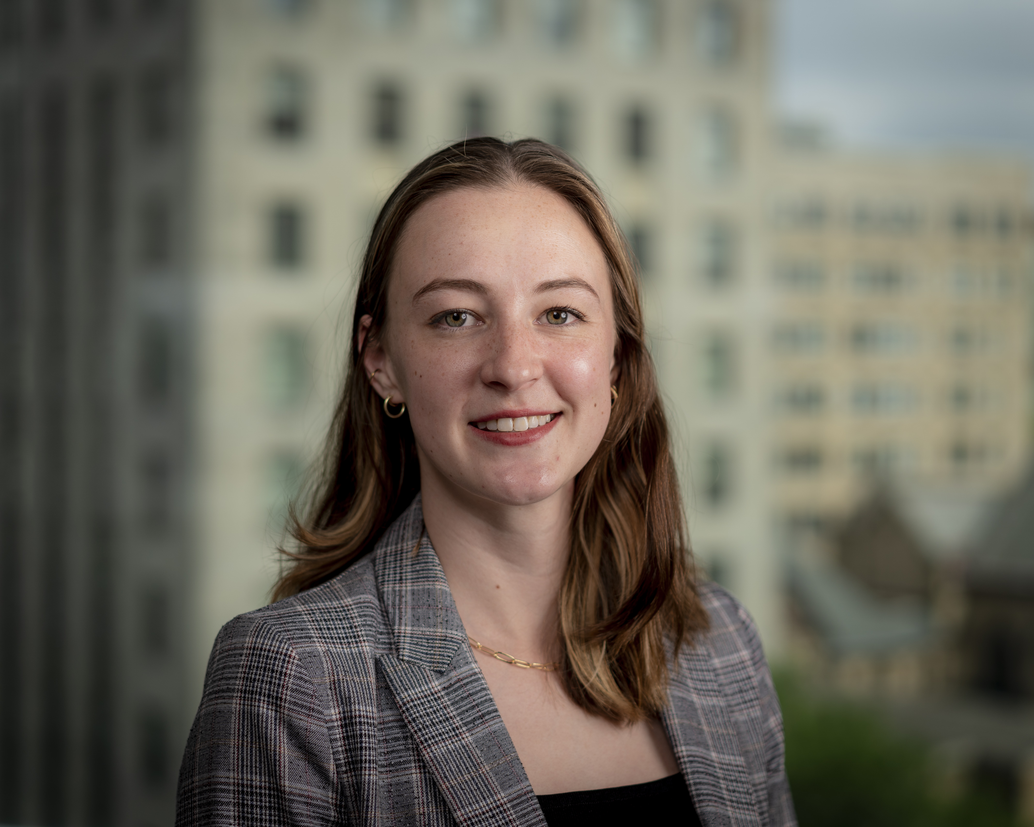
Contact
KATIE UJDAK
Global Trade & Investment Grants Specialist
katie.ujdak@wedc.org
608.210.6773
Email me to get access to Network Wisconsin and start your application today!

Slide 21
Wisconsin Agricultural export webinar – February 2023
AGENDA
Welcome and Opening Remarks
Secretary Randy Romanski
Export Expansion Grant FY22 Project Updates
Wisconsin Holstein Association – Ron Sersland President of Our Help Inc. (International Protein Sires)
Wisconsin Potato and Vegetable Growers Association (WPVGA), Dana Rady – Executive Director WPVGA, David Wickline - Sales and New Business Development Manager, Alsum Farms & Produce
Applying for the WEDC International Market Access Grant
Katie Ujdak – Global Trade and Investment Grant Specialist, Wisconsin Economic Development Corporation
Trade Promotion Activities February through June of 2023
Lisa Stout – International Development Consultant
Adjourn

Slide 22
DATCP Trade Promotion Activities February - June
February 20-23 Gulfood, UAE
WIAE funded – 2 Wisconsin dairy companies participating, Wisconsin Pavilion in the world’s largest annual food show
Leads: Lisa Stout, Shirley Acedo
March 9-10, VIV Asia, Bangkok, Thailand Agricultural Trade Show and Buyer Mission
WIAE, Food Export funded – 9 Wisconsin livestock, genetics, feed companies, 1 industry organization participating
Leads: Luis Santana, Jennifer Lu

Slide 23
DATCP trade promotion activities February - June
March 28 -30, SIAL Americas, Las Vegas, NV, Food Show
WIAE funded – 10 Wisconsin dairy, crop companies, meeting foreign dairy buyers, Dairy Farmers of Wisconsin booth
Lead: Shirley Acedo
April 25-28 Food and Hotel Asia Singapore, Food Export pavilion Food Show Plus activity
Food Export funded – Recruiting 3 Wisconsin dairy, crop companies
Lead: Lisa Stout

Slide 24
DATCP trade promotion activities February - June
May 2-7, SIAM, Meknes Morocco Agricultural Show Wisconsin Genomics Conference and Trade Mission
USLGE, STEP funded – Recruiting 6 Wisconsin livestock, genetics and feed companies
Lead: Luis Santana
May 9 – 12, Interzum Cologne Germany Wood Products Show Wisconsin Pavilion
STEP funded – Recruiting 5 Wisconsin wood products companies
Lead: Jennifer Lu
June 5-9, Wisconsin Inbound Wood Buyers Mission
WIAE funded – Recruiting 8 Wisconsin wood products companies, meeting foreign buyers
Lead: Jennifer Lu

Slide 25
DATCP trade Promotion activities February - June
June 8-11, Semana Verde Galicia Spain, Agricultural Products Show
STEP funded - Recruiting 4 Wisconsin livestock, genetics and feed companies, Wisconsin stand
Lead: Luis Santana
June 10-16, UK London and Manchester Wisconsin Agricultural Trade Mission
WIAE funded – Recruiting 6 Wisconsin dairy, genetics, feed, wood, ginseng, craft distilled spirits and beers, food products companies
Leads: Secretary Romanski, Staff: Shirley Acedo, Jennifer Lu, Mark Rhoda Reis
For more information on trade promotion activities please visit…
https://datcp.wi.gov/Pages/AgDevelopment/InternationalAgribusiness.aspx

Slide 26
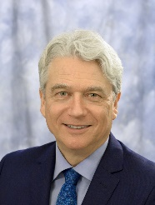
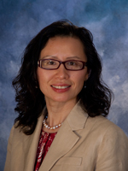
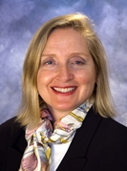
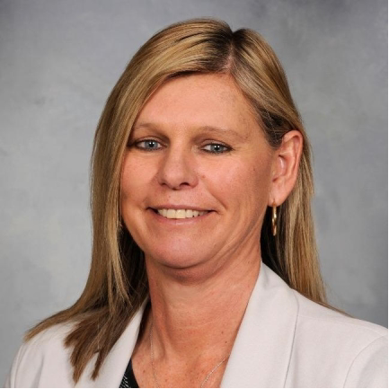
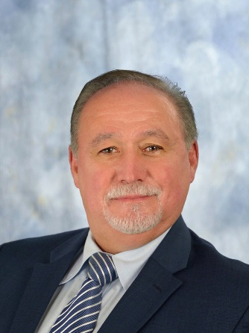
International Agribusiness Center Team
We are here to help!
Mark Rhoda-Reis
Director
Export and Business Development Bureau
608-224-5125
mark.rhodareis@wi.gov
Jennifer Lu
Economic Development Consultant
Animal Feed, Forestry Products, Livestock & Genetics
Asia
608-224-5102
jennifer.lu@wi.gov
Lisa Stout
Economic Development Consultant
Processed Foods and Food Ingredients
Asia, Canada, Middle East
608-224-5126
lisa.stout@wi.gov
Dr. Luis Enrique Santana
Economic Development Consultant
Animal Feed, Fertilizers, Livestock & Genetics
Canada, Latin America, Africa, European Union, Middle East
608-640-8075
luise.santana@wi.gov
Shirley Acedo
Economic Development Consultant
Processed Foods and Food Ingredients
Latin America, European Union, Middle East, Africa, South Asia
shirley.acedo@wi.gov
Amy Kennedy
Trade Promotion Activity Coordinator
715-965-0121
amy.kennedy@Wisconsin.gov

Slide 27
Wisconsin Agricultural export webinar – February 2023
AGENDA
Welcome and Opening Remarks
Secretary Randy Romanski
Export Expansion Grant FY22 Project Updates
Wisconsin Holstein Association – Ron Sersland President of Our Help Inc. (International Protein Sires)
Wisconsin Potato and Vegetable Growers Association (WPVGA), Dana Rady – Executive Director WPVGA, David Wickline - Sales and New Business Development Manager, Alsum Farms & Produce
Applying for the WEDC International Market Access Grant
Katie Ujdak – Global Trade and Investment Grant Specialist, Wisconsin Economic Development Corporation
Trade Promotion Activities February through June of 2023
Lisa Stout – International Development Consultant
Adjourn

Slide 28
Thank You
Lisa Stout
Wisconsin Agricultural Export Webinar
Lisa Stout (608) 514-4538 lisa.stout@Wisconsin.gov
February 15, 2023

